Slide 1
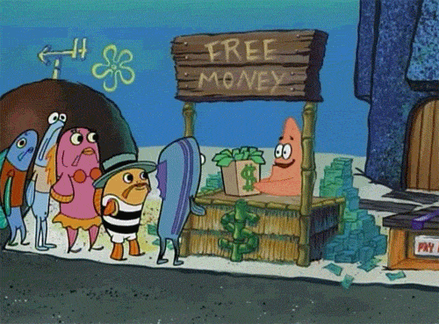
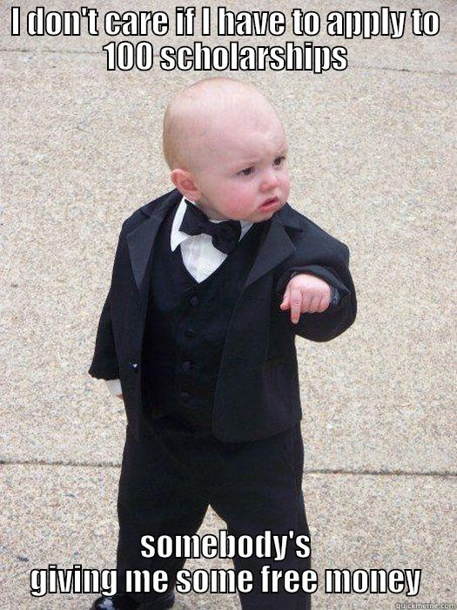
Introduction to Scholarships
SHS Scholarship Advisors:
Career & College Facilitator:
Mr. Gutual
Ms. Kaskie
Mrs. Yvana

Slide 2
WE ARE NOT SAYING YOU HAVE TO GO TO TRADITIONAL COLLEGE TO BE SUCCESSFUL
There is not one path to success
    Traditional “college” doesn’t work for everyone
    Going to college does not guarantee a good paying job
    COVID has changed life for all of us
Rethink “college”
Consider vocational, CTE, and trade schools
    This path can sometimes lead to better paying jobs in less time

Slide 3

The Career Center has lots of information on internships, apprenticeships, and popular trades & trade schools.

Slide 4
Scholarship Myths
Only smart students with really good GPAs get scholarships
  WRONG!
    There are scholarships that do not consider grades/GPAs
Scholarships are only for students with financial need
  WRONG!
    Many scholarships do not take financial need into account.
Only seniors can apply for scholarships
  WRONG!
    If you take the time to look, you will find scholarships intended for any grade
Undocumented students can’t apply for scholarships
  WRONG!
  There are scholarships specifically for undocumented students
You can only apply for scholarships for your first year of college
  WRONG!
  You can (and should!) apply for scholarships every year of college you attend
You can't apply for scholarships, because you don't know what you want to do or major in
  WRONG!
    Although it’s helpful to have a direction, it’s not always required to win a scholarship
THERE ARE SCHOLARSHIPS FOR EVERYONE!

Slide 5

Making Scholarships Work
Minimum Wage= $8.75
Average Scholarship= $500
60 Hours= 1 ½ weeks of work
$10= 50 Hours
  $12= 42 Hours
Most scholarships only take a few hours to apply for
You get faster the more you apply

Slide 6
Types of Aid
Merit Based
    Your academic history
    Your involvement
    Your achievements/ accomplishments
    Your resume
Need Based
      Your circumstances
      Your family’s income
      Your background/situation

Slide 7
Types of Aid
  Grants
    Don’t have to pay back
    Apply through FAFSA for many
            Example: Pell Grant
      Foundations & Corporations may also offer grants
Loans
  Have to pay back
  Apply through FAFSA
  Two types
    Subsidized= Better interest rate
      Don’t have to pay interest while in school
    Unsubsidized = Pay interest while in school; generally not need based
  A last resort- takes planning!

Slide 8


Types of Aid
Work Study
  On campus jobs= best jobs
  Apply through FAFSA
Scholarships
  Don’t have to pay back!
  Apply to as many as you can!
  Many schools have institutional scholarships and require students to fill out FAFSA to award them

Slide 9

Free Application for Federal Student Aid
    The best chance you have to get money!
    Easiest way to apply for multiple grants, scholarships, loans
    Most scholarships, require that you fill out FAFSA
    There is an alternative to FAFSA for undocumented students
    Opens Oct. 1st every year
      Deadline depends on school- FIRST COME, FIRST SERVE BASIS DON’T DELAY!
    SHS FAFSA Nights: In October in computer lab B4 & B5
      We host workshop events where FAFSA experts from local institutions come help you and your family fill out the form.
You keep saying, FAFSA, WHAT IS IT?????
https://studentaid.gov/h/apply-for-aid/fafsa

Slide 10
Applying for scholarships: TIPS
Look for local
Check out the scholarship websites of the schools you want to attend
Follow the right people on social media
Use us! TEAMS! Website! Bulletin Board!
Ask people who are already in college what they might have received
READ REQUIREMENTS
Never apply for a scholarship that asks you to pay or makes promises
Rework and revise your scholarship info- Save everything!
    Especially at the end of senior year, you will lose your access to WCSD OneDrive.
Don’t expect to get $$$$ if you only apply once

Slide 11
TMCC Nevada Promise Scholarship
“Last dollar” scholarship- kicks in after all other aid
Must graduate from a Nevada high school
  GED before the age of 20
Enrolled in a minimum of 12 credits
  Immediately enrolled after graduation
Complete all eligibility steps by the deadline
  Complete the application (DUE BY 10/31)
  Apply to TMCC & Register for classes
  Complete FAFSA
    (or Non-FAFSA Declaration)
  Complete Student Orientation
  Complete NV Promise Training
  Meet with assigned Mentor
  Complete 8 hours of community service by June 1
      NOT MERIT BASED
      FIRST COME, FIRST SERVE
COVERS ALMOST ALL TUITION FOR UP TO THREE YEARS OR UNTIL YOU FINISH YOUR ASSOCIATES DEGREE (2 years)* as of 2021

Slide 12

Sparks General Scholarship Application
  Multiple scholarships offered only to SPARKS STUDENTS!
  Must apply to be considered
  Typically opens: Second Semester

Slide 13

What to work on now?
Prepare your and your family’s tax information
  FASFA= December 1 & FAFSA NIGHTS!
Research: Where do you want to go? How much is it going to cost?
  Start a budget!
  Application deadlines?
Get involved: clubs, volunteering, internships?
Ask questions, make connections
  Talk to people who do what you want to do
  Focus on collecting skills & experiences
Consider who you can use as references
  Recommendation Letter Forms Available
    Don't ask for a letter until you have something to apply for and give plenty of time for teachers to complete
Start to look for scholarships now
Update or create your resume
Write scholarship essay drafts

Slide 14



It’s all on you
Follow us
@sparkshighcareercenter
  If you aren’t willing to work for the money, someone else is.

